Slide 1
Classification: Naïve Bayes and Decision Tree

Slide 2
Decision tree regression
Decision tree builds regression models in the form of a tree structure. It breaks down a dataset into smaller and smaller subsets while at the same time an associated decision tree is incrementally developed. The final result is a tree with decision nodes and leaf nodes. A decision node (e.g., Outlook) has two or more branches (e.g., Sunny, Overcast and Rainy), each representing values for the attribute tested. Leaf node (e.g., Hours Played) represents a decision on the numerical target. The topmost decision node in a tree which corresponds to the best predictor called root node. Decision trees can handle both categorical and numerical data.

Slide 3
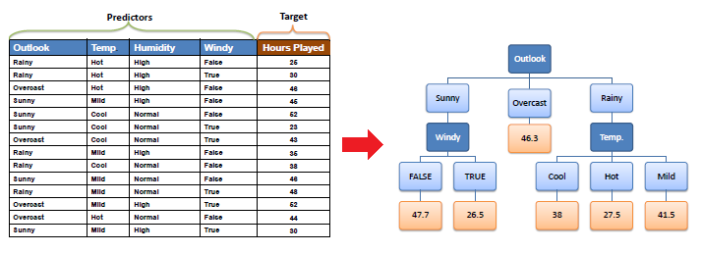
Decision tree regression observes features of an object and trains a model in the structure of a tree to predict data in the future to produce meaningful continuous output. Continuous output means that the output/result is not discrete, i.e., it is not represented just by a discrete, known set of numbers or values.
Discrete output example: A weather prediction model that predicts whether or not there’ll be rain in a particular day. Continuous output example: A profit prediction model that states the probable profit that can be generated from the sale of a product.

Slide 4
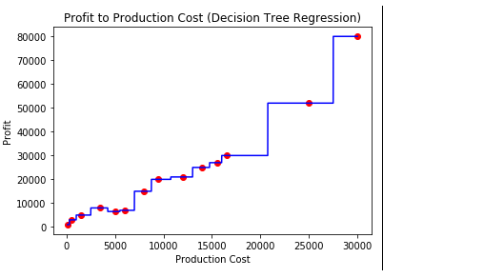
Code:
# import the regressor
from sklearn.tree import DecisionTreeRegressor
# create a regressor object
regressor = DecisionTreeRegressor(random_state = 0)
# fit the regressor with X and Y data
regressor.fit(X, y)

Slide 5
Random forest regression
The Random Forest is one of the most effective machine learning models for predictive analytics, making it an industrial workhorse for machine learning.
The random forest model is a type of additive model that makes predictions by combining decisions from a sequence of base models. Here, each base classifier is a simple decision tree. This broad technique of using multiple models to obtain better predictive performance is called model ensembling. In random forests, all the base models are constructed independently using a different subsample of the data

Slide 6
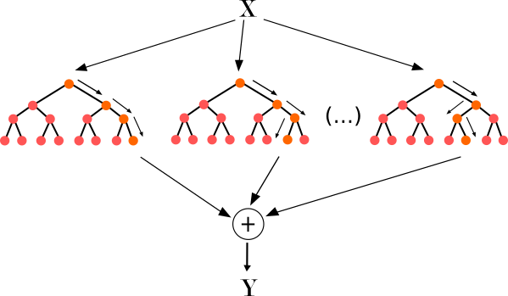
Approach :
Pick at random K data points from the training set.
Build the decision tree associated with those K data points.
Choose the number Ntree of trees you want to build and repeat step 1 & 2.
For a new data point, make each one of your Ntree trees predict the value of Y for the data point, and assign the new data point the average across all of the predicted Y values.

Slide 7
Code
# import the regressor
from sklearn.tree import DecisionTreeRegressor
# create a regressor object
regressor = DecisionTreeRegressor(random_state = 0)
# fit the regressor with X and Y data
regressor.fit(X, y)

Slide 8
Naive Bayes Classifiers
collection of classification algorithms

Slide 9
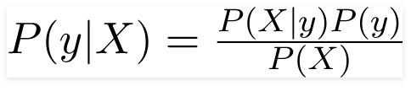
Principle of Naive Bayes Classifier:
Bayes theorem can be rewritten as:
A Naive Bayes classifier is a probabilistic machine learning model that’s used for classification task. The crux of the classifier is based on the Bayes theorem.
Bayes theorem can be rewritten as:
It is not a single algorithm but a family of algorithms where all of them share a common principle, i.e. every pair of features being classified is independent of each other.

Slide 10
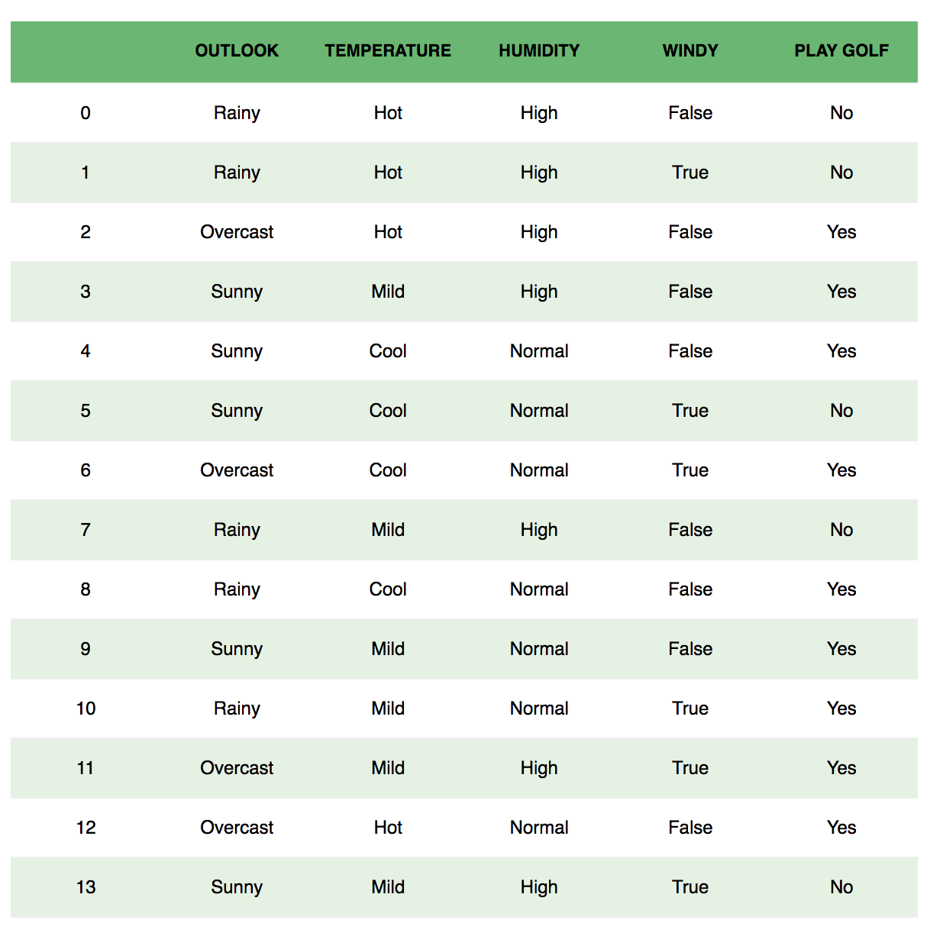
Example: Let us take an example to get some better intuition. Consider the problem of playing golf. The dataset is represented as below.

Slide 11

We classify whether the day is suitable for playing golf, given the features of the day. The columns represent these features and the rows represent individual entries. If we take the first row of the dataset, we can observe that is not suitable for playing golf if the outlook is rainy, temperature is hot, humidity is high and it is not windy. We make two assumptions here, one as stated above we consider that these predictors are independent. That is, if the temperature is hot, it does not necessarily mean that the humidity is high. Another assumption made here is that all the predictors have an equal effect on the outcome. That is, the day being windy does not have more importance in deciding to play golf or not.
According to this example, Bayes theorem can be rewritten as:
The variable y is the class variable(play golf), which represents if it is suitable to play golf or not given the conditions. Variable X represent the parameters/features.

Slide 12

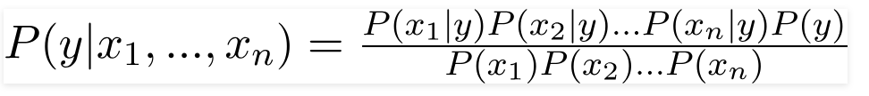


In our case, the class variable(y) has only two outcomes, yes or no. There could be cases where the classification could be multivariate. Therefore, we need to find the class y with maximum probability.
X is given as,
Here x_1,x_2….x_n represent the features, i.e they can be mapped to outlook, temperature, humidity and windy. By substituting for X and expanding using the chain rule we get,
Now, you can obtain the values for each by looking at the dataset and substitute them into the equation. For all entries in the dataset, the denominator does not change, it remain static. Therefore, the denominator can be removed and a proportionality can be introduced.
In our case, the class variable(y) has only two outcomes, yes or no. There could be cases where the classification could be multivariate. Therefore, we need to find the class y with maximum probability.
Using the above function, we can obtain the class, given the predictors.

Slide 13
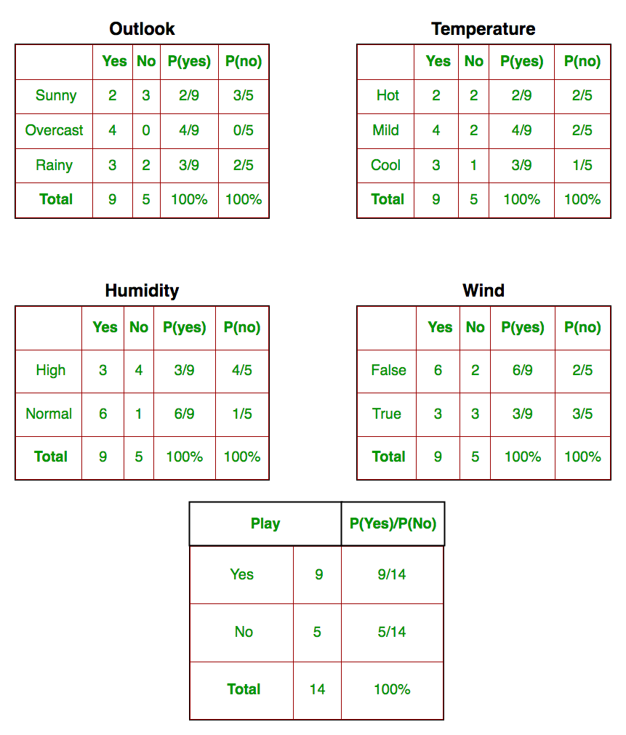
We need to find P(x_{i} | y_{j}) for each x_{i} in X and y_{j} in y. All these calculations have been demonstrated in the tables below:
So, in the figure above, we have calculated P(x_{i} | y_{j}) for each x_{i} in X and y_{j} in y manually in the tables 1-4. For example, probability of playing golf given that the temperature is cool, i.e P(temp. = cool | play golf = Yes) = 3/9.

Slide 14
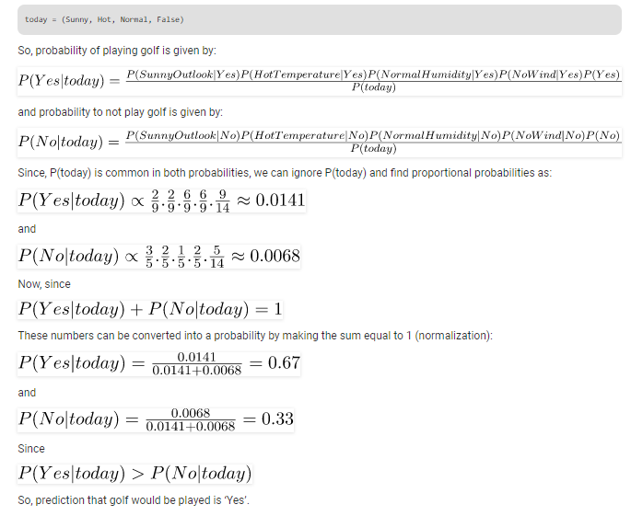
Also, we need to find class probabilities (P(y)) which has been calculated in the table 5. For example, P(play golf = Yes) = 9/14.
So now, we are done with our pre-computations and the classifier is ready!
Let us test it on a new set of features (let us call it today):

Slide 15
Types of Naive Bayes Classifier:
Multinomial Naive Bayes: This is mostly used for document classification problem, i.e whether a document belongs to the category of sports, politics, technology etc. The features/predictors used by the classifier are the frequency of the words present.
Bernoulli Naive Bayes: This is similar to the multinomial naive bayes but the predictors are boolean variables. The parameters that we use to predict the class variable take up only values yes or no, for example if a word occurs in the text or not.
Gaussian Naive Bayes: When the predictors take up a continuous value and are not discrete, we assume that these values are sampled from a gaussian distribution.

Slide 16
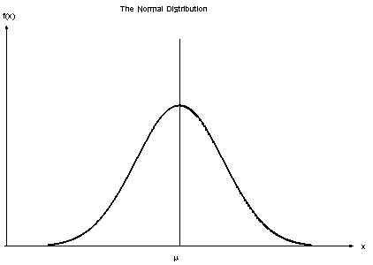
Gaussian Distribution(Normal Distribution)
Conclusion:
Naive Bayes algorithms are mostly used in sentiment analysis, spam filtering, recommendation systems etc. They are fast and easy to implement but their biggest disadvantage is that the requirement of predictors to be independent. In most of the real life cases, the predictors are dependent, this hinders the performance of the classifier.

Slide 17
Decision Tree
Classification Algorithm

Slide 18
Decision tree algorithm falls under the category of supervised learning. They can be used to solve both regression and classification problems..
Decision tree builds classification or regression models in the form of a tree structure. It breaks down a dataset into smaller and smaller subsets while at the same time an associated decision tree is incrementally developed. The final result is a tree with decision nodes and leaf nodes. A decision node (e.g., Outlook) has two or more branches (e.g., Sunny, Overcast and Rainy). Leaf node (e.g., Play) represents a classification or decision. The topmost decision node in a tree which corresponds to the best predictor called root node. Decision trees can handle both categorical and numerical data.
We can represent any boolean function on discrete attributes using the decision tree.
Types of decision trees
Categorical Variable Decision Tree: Decision Tree which has categorical target variable then it called as categorical variable decision tree.
Continuous Variable Decision Tree: Decision Tree which has continuous target variable then it is called as Continuous Variable Decision Tree.

Slide 19
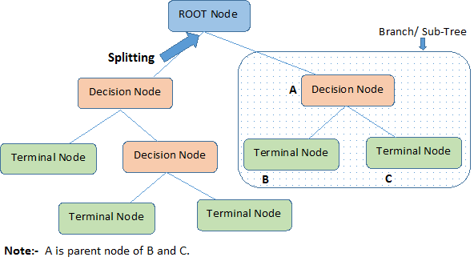
Root Node: It represents entire population or sample and this further gets divided into two or more homogeneous sets.
Splitting: It is a process of dividing a node into two or more sub-nodes.
Decision Node: When a sub-node splits into further sub-nodes, then it is called decision node.
Leaf/ Terminal Node: Nodes with no children (no further split) is called Leaf or Terminal node.
Pruning: When we reduce the size of decision
trees by removing nodes (opposite of Splitting),
the process is called pruning.
Branch / Sub-Tree: A sub section of decision
tree is called branch or sub-tree.
Parent and Child Node: A node, which is divided
into sub-nodes is called parent node of sub-nodes
where as sub-nodes are the child of parent node.

Slide 20
Algorithm
Algorithms used in decision trees:
ID3
Gini Index
Chi-Square
Reduction in Variance
The core algorithm for building decision trees is called ID3. Developed by J. R. Quinlan and it uses Entropy and Information Gain to construct a decision tree.
The ID3 algorithm begins with the original set S as the root node. On each iteration of the algorithm, it iterates through every unused attribute of the set S and calculates the entropy H(S)or information gain IG(S) of that attribute. It then selects the attribute which has the smallest entropy (or largest information gain) value. The set S is then split or partitioned by the selected attribute to produce subsets of the data

Slide 21
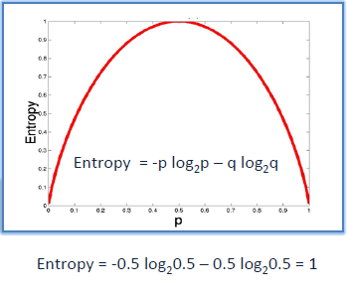
Entropy
Entropy is a measure of the randomness in the information being processed. The higher the entropy, the harder it is to draw any conclusions from that information. Decision tree algorithm uses entropy to calculate the homogeneity of a sample. If the sample is completely homogeneous the entropy is zero and if the sample is an equally divided it has entropy of one.

Slide 22
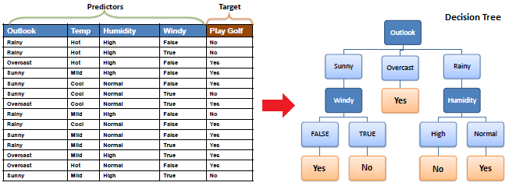
Example:

Slide 23
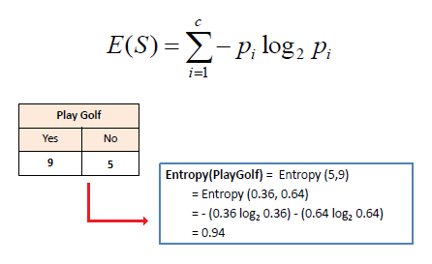
To build a decision tree, we need to calculate two types of entropy using frequency tables as follows:
a) Entropy using the frequency table of one attribute:

Slide 24
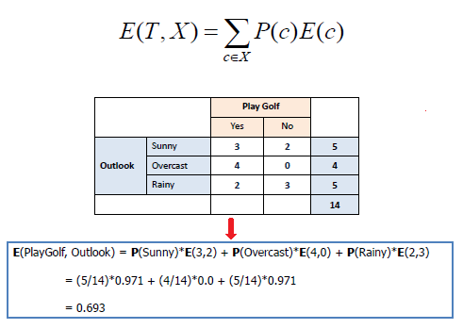
b) Entropy using the frequency table of two attributes:

Slide 25
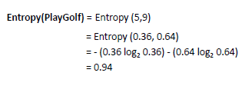
Information gain
The information gain is based on the decrease in entropy after a dataset is split on an attribute. Constructing a decision tree is all about finding attribute that returns the highest information gain (i.e., the most homogeneous branches).
Step 1: Calculate entropy of the target.

Slide 26
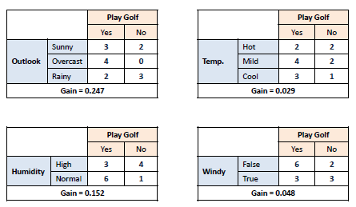
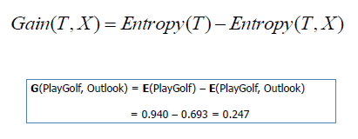
Step 2: The dataset is then split on the different attributes. The entropy for each branch is calculated. Then it is added proportionally, to get total entropy for the split. The resulting entropy is subtracted from the entropy before the split. The result is the Information Gain, or decrease in entropy.

Slide 27
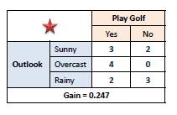
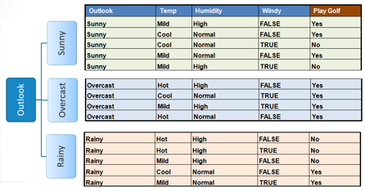
Step 3: Choose attribute with the largest information gain as the decision node, divide the dataset by its branches and repeat the same process on every branch.

Slide 28
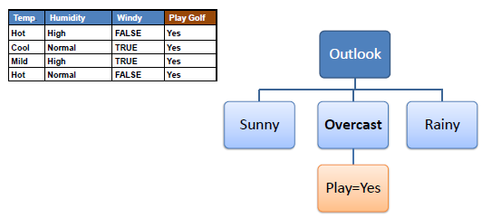
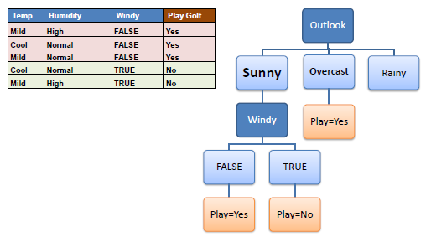
Step 4a: A branch with entropy of 0 is a leaf node
Step 4b: A branch with entropy more than 0 needs further splitting

Slide 29
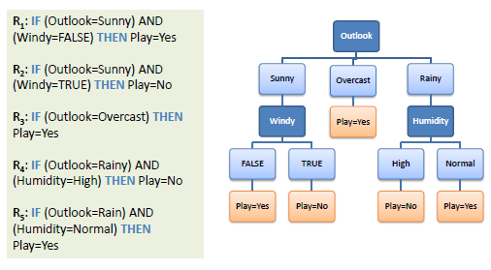
Step 5: The ID3 algorithm is run recursively on the non-leaf branches, until all data is classified.
Decision Tree to Decision Rules
A decision tree can easily be transformed to a set of rules by mapping from the root node to the leaf nodes one by one.

